Slide 1
Representation of Numbers and Characters
Course Code: COE 3205
Course Title: Computer Organization & Architecture
Dept. of Computer Science
Faculty of Science and Technology
Lecturer No: | 02 | Week No: | 02 | Semester: | 21-22 Summer
Lecturer: | NOBORANJAN DEY; noboranjan@aiub.edu

Slide 2
Lecture Outline
Number System
Conversion Between Number Systems
Addition and Subtraction
Integer Representation in computer
Character encoding and usage by computer (ASCII Code)

Slide 3
Number System
Topic sub heading..
Decimal Numbers
Binary Number system
Hexadecimal Number system

Slide 4
Number System
Decimal Numbers
In a positional number system
Each digit in the number is associated with a power of 10.
i.e.3245 = 3 thousands, 2 hundreds, 4 tens and 5 ones.
OR, 3245 = 3X(10^3)+2X(10^2)+4X(10^1)+5X(10^0)
In a positional number system
A number b is selected as the base
Symbols are assigned to numbers between 0 and b-1
In decimal system symbols are 0,1,2,3,4,5,6,7,8,9.
The base ten is represented as 10

Slide 5
Number System
Binary Number System
The base is two
There are only two digits, 0 and 1.
i.e. binary string 11010 represent the number 1X(2^4)+1X(2^3)+0X(2^2)+1X(2^1)+0X(2^0) = 26
Base two is represented in binary as 2

Slide 6
Number System
Why Hexadecimal?
We have decimal and binary. Why Hex?
Binary:
Numbers written in binary tend to be long and difficult to express
16 bits are needed to represent a word in 8086-based computer.
Decimal:
Difficult to convert into binary.
*** Thus a third number became necessary

Slide 7
Number System
Hexadecimal Number System
The base is sixteen
There are total sixteen digits: 0,1,2,3,4,5,6,7,8,9,A,B,C,D,E,F
i.e. hex digit 4A represent the number:
4X(16^1)+ AX(16^0) = 74
Base sixteen is represented in hex as 16
Conversion between binary and hex is easy
Sixteen is = 2^4, So each hex digit corresponds to a unique four-bit number.

Slide 8
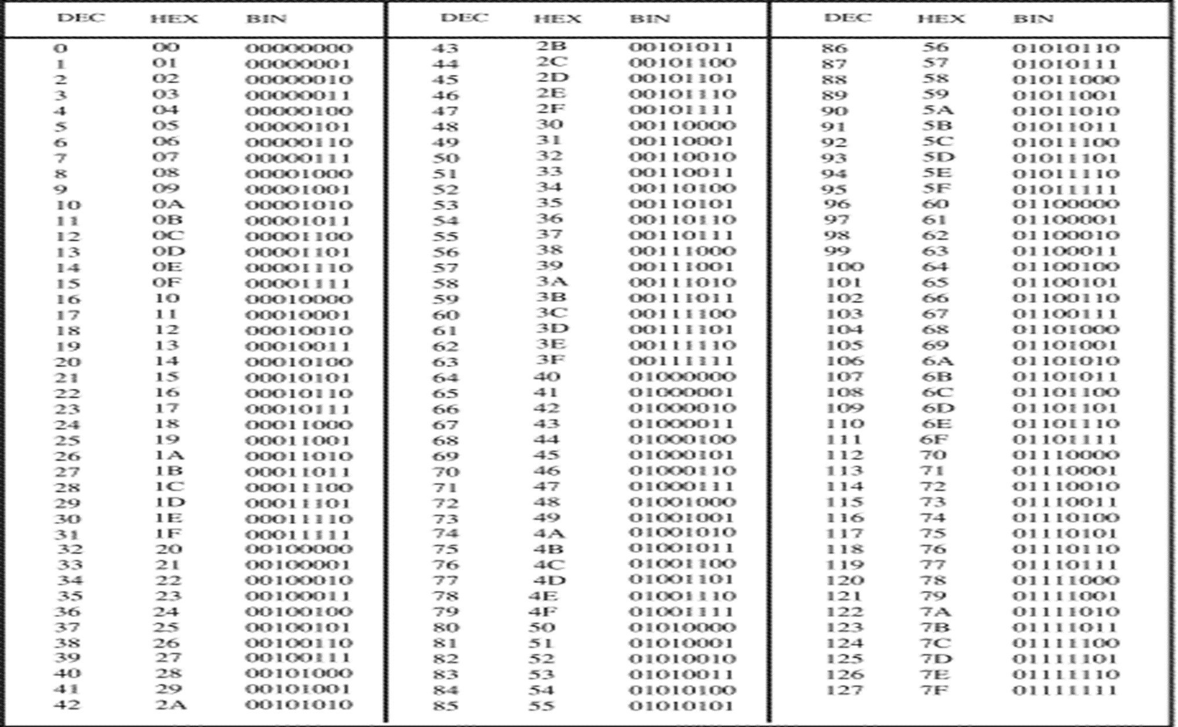
Number System
Decimal, Binary and Hex Numbers

Slide 9
Conversion Between Number Systems
Binary to decimal
Decimal to Binary
Hexadecimal to Decimal
Decimal to Hex
Hex to Binary
Binary to Hex

Slide 10
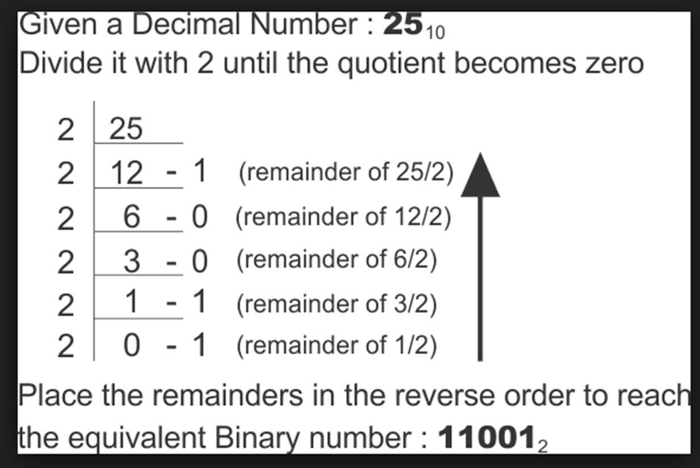
Conversion Between Number Systems
Decimal to Binary
Convert the Decimal number 25 in Binary.

Slide 11
Conversion Between Number Systems
Hexadecimal to Decimal
Convert hex number 589 into decimal number.
=5*(16^2)+8*(16^1)+9*(16^0)
= 1280+128+9
= 1417

Slide 12
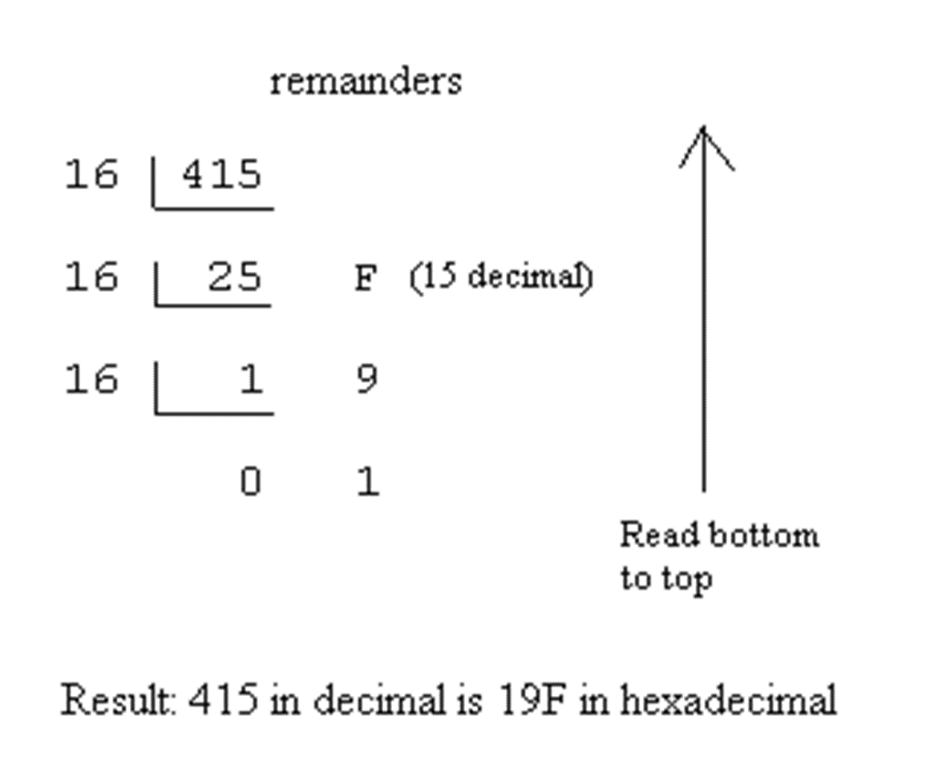
Conversion Between Number Systems
Decimal to Hex
Convert 415 to Hex

Slide 13
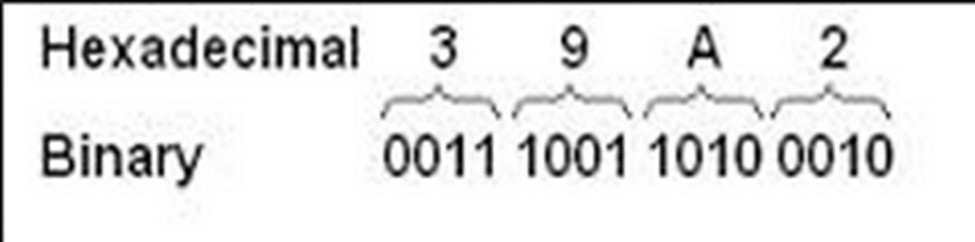
Conversion Between Number Systems
Hex to Binary
Convert 39A2h to Binary

Slide 14
Conversion Between Number Systems
Binary to Hex
Convert the Binary number 1000011001000011 into Hex
1000 0110 0100 0011
8 6 4 3
Convert the Binary number 10010010010001001101011011111 into Hex

Slide 15
Conversion Between Number Systems
Conversion Task: Binary and Hex to Decimal
1110b
100101011101b
46Ah
FAE2Ch

Slide 16
Conversion Between Number Systems
Conversion Task: Decimal and Hex into Binary
97
627
A2Ch
B34Dh

Slide 17
Addition and Subtraction
Hex Addition
Binary Addition
Hex Subtraction
Binary Subtraction

Slide 18

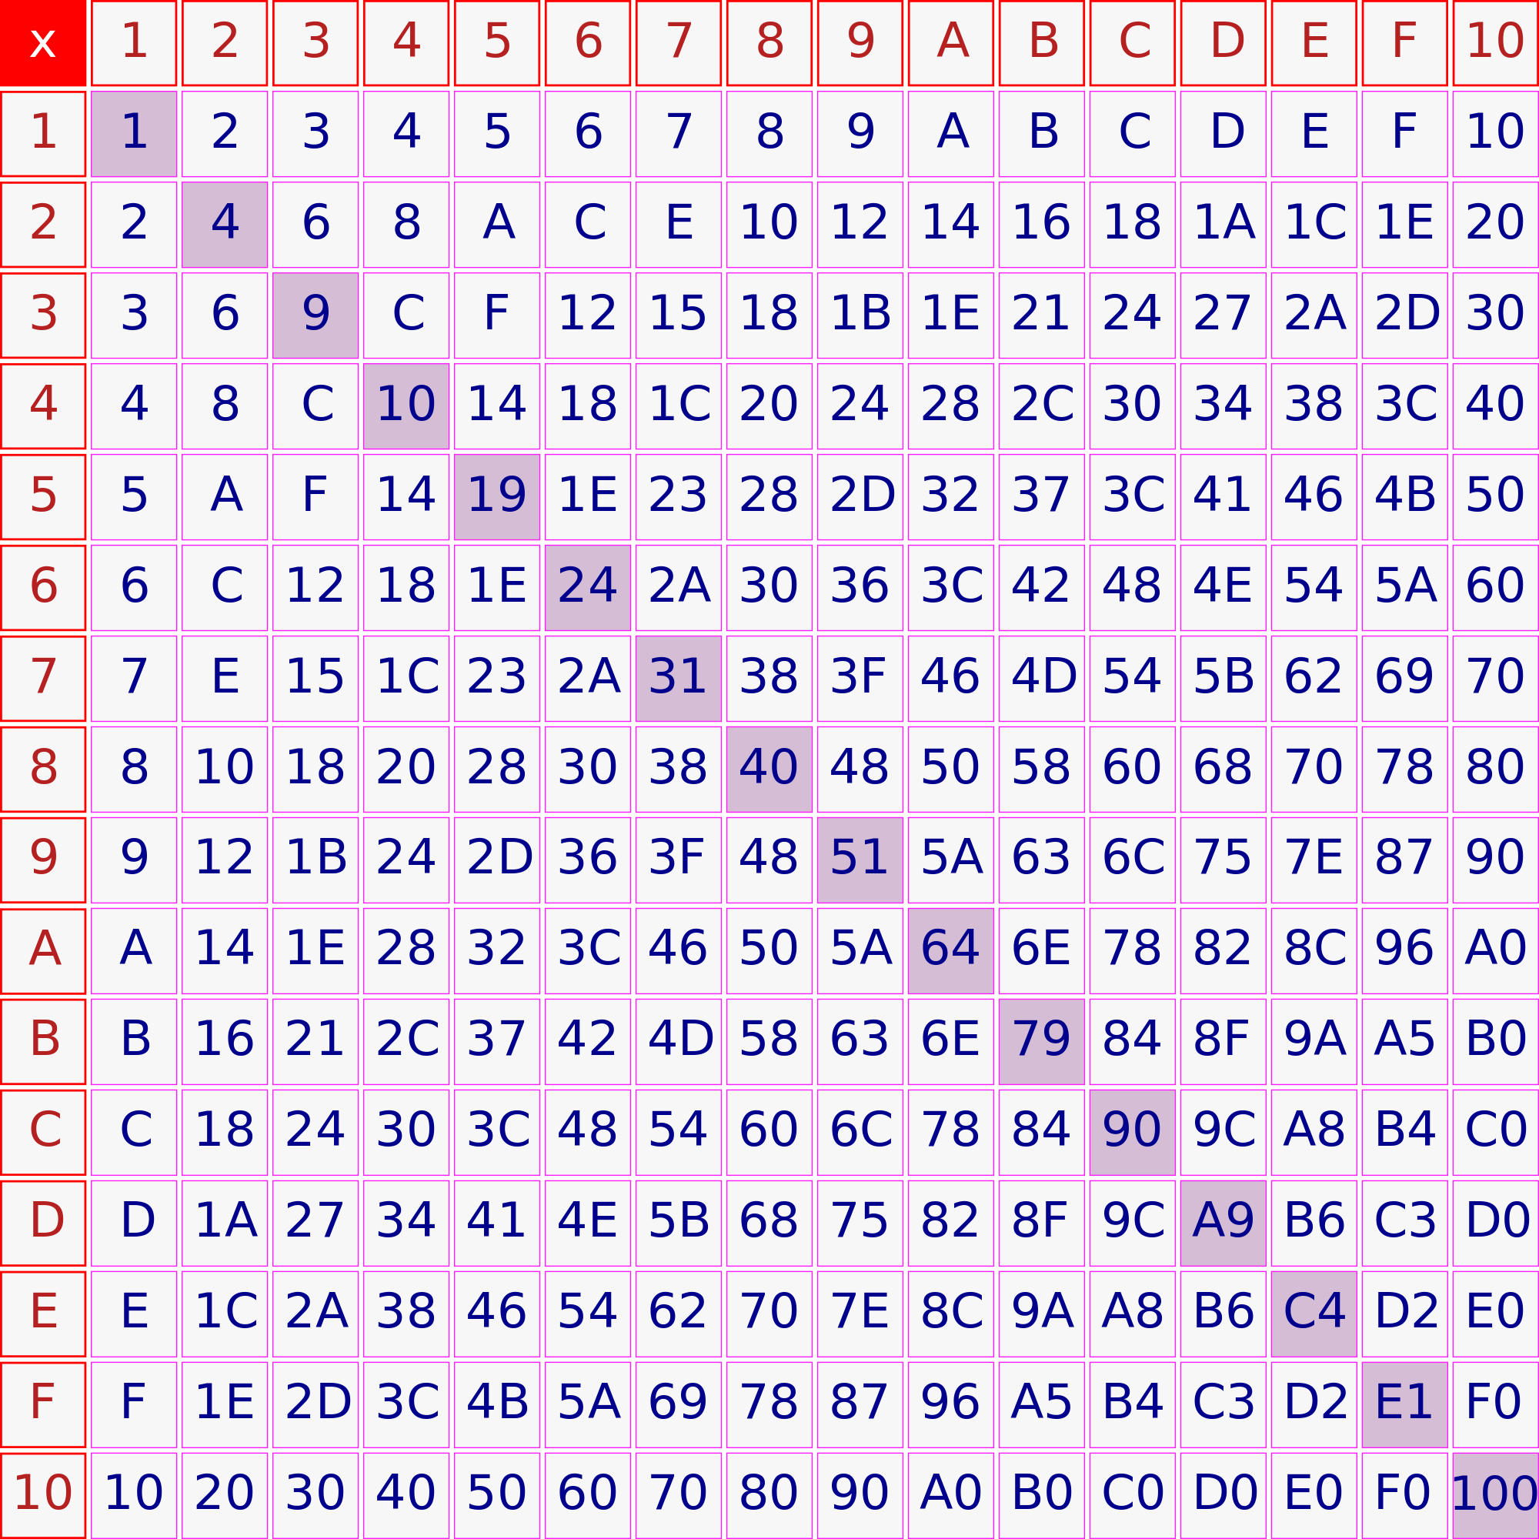
Addition and Subtraction
Hex Multiplication Table

Slide 19
Addition and Subtraction
Hex Addition
Add hex number 5B39h with 7AF4h
In Unit’s column 9h+4h=13d=Dh
In next column, 3h+Fh=12h, we write 2 and carry 1
In next column, Bh+Ah+ 1h (from previous carry)= 16h , we write 6 and carry 1
Finally, in last column, we compute, 5h+7h+1=Dh
thus, if we combine it all,
5B39h
7AF4h
=====
D62Dh

Slide 20
Addition and Subtraction
Task: Hex Addition
Solve the following:
B23CDh + 17912h
FEFFEh + FBCADh

Slide 21
Addition and Subtraction
Binary Addition
Add binary number 100101111b with 110110b
add some padding Zero with small number. So 110110b becomes 000110110b
In Unit’s column 1b+0b=1b
In next column, 1b+1b=10b, we write 0 and carry 1
In next column, 1b+1b+1b (from previous carry)= 11b , we write 1 and carry 1
In next column, 1b+0b+1b (from previous carry)= 10b , we write 0 and carry 1
In next column, 0b+1b+1b (from previous carry)= 10b , we write 0 and carry 1
In next column, 1b+1b+1b (from previous carry)= 11b , we write 1 and carry 1
In next column, 0b+0b+1b (from previous carry)= 1b , we write 1 and No Carry
In next column, 0b+0b+No carry = 0b
In Last column, 1b+0b = 1b
thus, if we combine it all,
100101111b
000110110b
=========
101100101b

Slide 22
Addition and Subtraction
Task: Binary Addition
Solve the following:
100101b+10111b
100111101b+10001111001b

Slide 23
Addition and Subtraction
Subtraction: Hex
Subtract hex number BA94h from D26Fh
In Unit’s column Fh-4h=11d=Bh
In next column, 6<9 so, we must borrow 1 from the third (right to left) column. Thus, 16h-9h=?
16h-9h = Dh, (Looking at Hex addition table, D+9=16
Or, Hex numbers are A…F,10,11,12,13,14,15,16h/23d - 9d/h = 14d/Dh
In next column, 12h-Ah-1(previously lend one) = 12h/18d-10d-1d/h = 7h
In next column, Dh-Bh-1(previously lend one) = Dh/13d-11d-1d/h = 1h
thus, if we combine it all,
D26Fh
- BA94h
=====
17DBh

Slide 24
Addition and Subtraction
Task: Hex Subtraction
Solve the following:
5FC12h-3ABD1h
F001Ch-1FF3Fh

Slide 25
Addition and Subtraction
Task: Binary Subtraction
Solve the following:
11011b-10110b
10000101b-111011b

Slide 26
Integer Representation in computer
Hardware of a computer restricts the size of a number can be stored.
lsb = least significant bit [Right most bit or bit 0]
msb = most significant bit [left most bit or bit 15]

Slide 27
Integer Representation in computer
Unsigned integers
Unsigned integers: Non-negative integer
The largest unsigned integer of a byte= 11111111b or 255d or FFh
The largest unsigned integer of a word= 1111111111111111b or 65535d or FFFFh
*** if LSB of an integer is 1 then its ODD . However, if it is 0 then Even

Slide 28
Integer Representation in computer
Signed Integer
Signed Integer: Can be positive or negative number
The MSB is reserved for the sign
MSB =1 [Negative]
MSB =0 [Positive]
*** Negative integers are stored in a computer using TWO’s complement

Slide 29
Integer Representation in computer
One’s Complement
Ones complement is obtained by complementing each bit.
i.e. replacing 0 by a 1 and 1 by a 0.
To find the one’s complement of 5 or 0000000000000101 [16bit representation of 101]
1111111111111010 [complementing each bit]

Slide 30
Integer Representation in computer
Two’s Complement
To get Two’s Complement,
Add 1 to the one’s complement of a number
Thus, Two’s complement of 5 is
1111111111111010 [one’s complement of 5]
+1
—————————
1111111111111011 [Two’s complement of 5]

Slide 31
Integer Representation in computer
Two’s Complement- Observation
If we add two’s complement of 5 with it, we get
1111111111111011
0000000000000101 ===============
10000000000000000
We get total 17bits here, however, word bits can hold only 16bits.
Thus the carried out MSB 1 is lost and final result is 0
5 +(-5) also results zero.
Adding a number N and ones complement gives 16 one’s
Adding a number N and Two’s complement gives 16 zero’s

Slide 32
Integer Representation in computer
Two’s Complement- Task: 8/16bit Representation
Find the two’s complement of the two’s complement of 5.
Show how the following decimal integer would be represented in
a) 8 bits b)16bits. [express the result in hex]
-97
-120
-40000
-128
65536

Slide 33
Integer Representation in computer
Two’s Complement- Task
Give 16-bit representation of each of the following integers and express the result in hex:
234
-16
31634
-32216

Slide 34
Integer Representation in computer
Subtraction as Two’s Complement Addition
If AX contains 5ABCh and BX contains 21FCh, Find the difference of AX minus BX by using complementation and addition.
AX= 5ABCh = 0101101010111100
BX= 21FCh = 0010000111111100
5ABCh = 0101 1010 1011 1100
+ One’s com. of 21FCh = 1101 1110 0000 0011
+1
Difference = 1 0011 1000 1100 0000 = 38C0h
A one is carried out of the most significant bit and is lost.
The answer stored, 38C0h, is correct, as may be verified by hex subtraction.

Slide 35
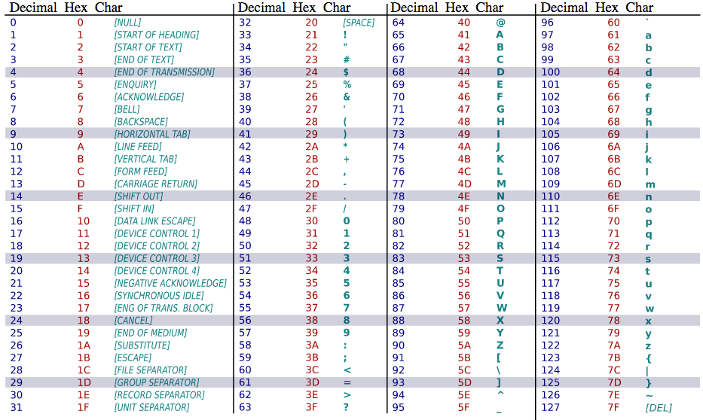
ASCII Code
ASCII Table

Slide 36
ASCII Code
ASCII in detail
ASCII code system Uses 7bits = 2^7 =128 to code each character.
Codes from 32 to 126 = 95 characters are only printable.
** to display the character A on the screen, a program sends the ASCII code 41h to the screen.
If we type “RG 2z” in computer, it will process like following:
Address | Character | ASCII Code | Content
0 | R | 52 | 0101 0010
1 | G | 47 | 0100 0111
2 | Space | 20 | 0010 0000
3 | 2 | 32 | 0011 0010
4 | z | 7A | 0111 1010

Slide 37
Topic Heading..
Task: String Processing in a Computer
If we want to print “Hello World” on the screen, How the memory will look like ?
[Hint: Find ASCII code, content of string from the ASCII table and order them in a address sequence].

Slide 38
Books
Assembly Language Programing and Organization of the IBM PC
Ytha Yu
Charles Marut

Slide 39
References
Number Systems Introduction - Decimal, Binary, Octal, Hexadecimal & Conversions
https://www.youtube.com/watch?v=L2zsmYaI5ww&t=1435s
Hex Addition, Subtraction
https://www.youtube.com/watch?v=y0B6tuC6niE
https://www.youtube.com/watch?v=3mV7q3_OAGM
Binary Addition , Subtraction
https://www.youtube.com/watch?v=TaQS3qSDXV0
Two’s Complement
https://www.youtube.com/watch?v=_7RK3rsfQ8w
ASCII Code
https://www.youtube.com/watch?v=KYEDJChGxh8
youtube.com/watch?v=5aJKKgSEUnY

